Slide 1
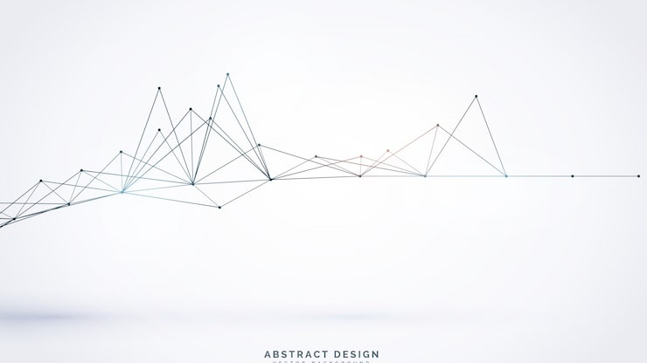
Customer Shopping
Behavior Analysis
By:- Sujeet Kumar
Transforming Data into Strategic Business Insights
A comprehensive analysis of 3,900 transactions to uncover spending patterns, customer segments, and product preferences
Transactions
Data Points
Key Insights
3,900
18
10+

Slide 2
01
Project Overview
Strategic objectives and scope
Executive Overview
02
Data Foundation
Dataset summary and methodology
03
Analytical Methodology
Python and SQL analysis approach
A structured exploration of customer behavior patterns, from data foundation to strategic recommendations.
04
Customer Insights
Segmentation and behavior patterns
05
Revenue Analysis
Demographics and spending patterns
06
Product Performance
Analysis Framework
Ratings and category analysis
Data → Insights → Strategy → Action
07
Business Recommendations
Strategic initiatives for growth

Slide 3
01
Project Overview
Strategic Objective
Key Metrics
This project analyzes customer shopping behavior using transactional data from 3,900 purchases across various product categories to uncover actionable business insights.
Transactions
3,900
Spending Patterns
Customer Segments
Complete records
Identify revenue drivers and customer value segments
Classify customers by behavior and loyalty status
Data Features
Product Preferences
Subscription Behavior
18
Understand category performance and preferences
Analyze subscription impact on customer value
Behavioral dimensions
Data Quality
99%
Complete dataset
Analysis Focus
Revenue optimization
Customer segmentation
Product positioning
Business Impact
Subscription strategy
Insights from this analysis will guide strategic decisions in customer retention , product positioning , and revenue optimization .

Slide 4
02
Data Foundation
Comprehensive dataset with 3,900 transactions and 18 behavioral features spanning customer demographics, purchase details, and shopping behavior patterns.
Customer Demographics
Purchase Details
Shopping Behavior
Age: Grouped for analysis
Item: Product purchased
Discount Applied: Usage patterns
Gender: Male vs. female patterns
Category: Product classification
Review Rating: Customer satisfaction
Location: Geographic distribution
Amount: Purchase value (USD)
Shipping Type: Standard vs. Express
Subscription: Status and impact
Season: Purchase timing
Previous Purchases: Loyalty indicator
Size & Color: Product attributes
Purchase Frequency: Visit patterns
Total Records
Features
Missing Data
Completeness
Categories
3,900
18
37
99%
5+
Data Quality: Missing values in Review Rating column (37/3,900 = 0.95%) were imputed using median rating by product category, ensuring 99%+ data completeness without compromising analytical integrity.

Slide 5
03
Analytical Methodology
Two-phase analytical approach combining Python data engineering with SQL business intelligence for comprehensive insights.
Phase 1: Python
Phase 2: SQL
Data Preparation & Engineering
Business Intelligence Queries
Data Loading & Exploration
Revenue Analysis
Imported dataset using pandas, checked structure with df.info(), and generated summary statistics with .describe()
Compared revenue by gender, age groups, and subscription status
Customer Segmentation
Missing Data Handling
Classified customers into New, Returning, and Loyal segments
Imputed missing Review Rating values using median by product category, preserving data integrity
Product Performance
Identified top-rated products and discount-dependent items
Feature Engineering
Behavior Patterns
Created age_group and purchase_frequency_days columns for enhanced segmentation
Analyzed shipping preferences and high-spending discount users
Statistical Validation
Database Integration
Compared purchase patterns between Standard and Express shipping
Connected Python to PostgreSQL and loaded cleaned DataFrame for SQL analysis
Technical Stack: Python (pandas, NumPy) → PostgreSQL → Power BI Dashboard, ensuring reproducible analysis and scalable insights .

Slide 6
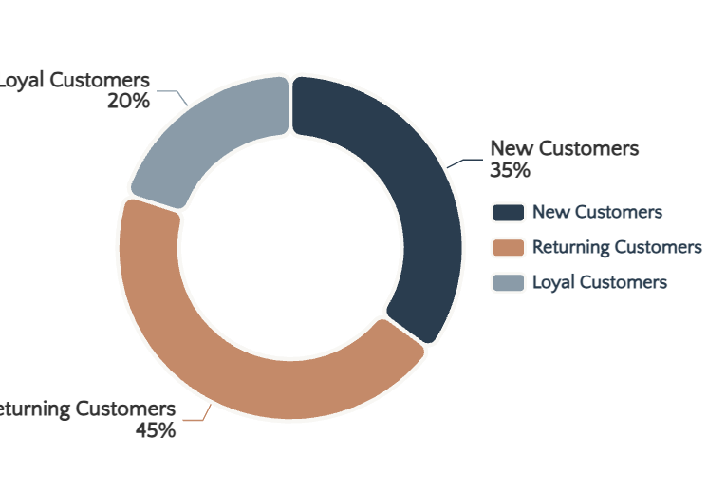
04
Customer Insights
Customer segmentation reveals distinct behavioral groups, enabling targeted marketing strategies and personalized experiences.
Segment Distribution
New Customers
35%
First-time purchasers with single transaction history. Represents acquisition opportunity.
Strategy:
Onboarding campaigns & welcome offers
Returning Customers
45%
Customers with 2-5 purchases showing engagement. Key conversion target.
Strategy:
Loyalty programs & personalized recommendations
Loyal Customers
20%
High-frequency purchasers (5+ purchases). Most valuable segment.
Strategy:
VIP benefits & exclusive access
Segmentation Criteria
Key Finding
Next Action
Based on purchase frequency: New (1), Returning (2-5), Loyal (5+)
65% of customers have potential for increased value
Implement targeted retention campaigns by segment

Slide 7
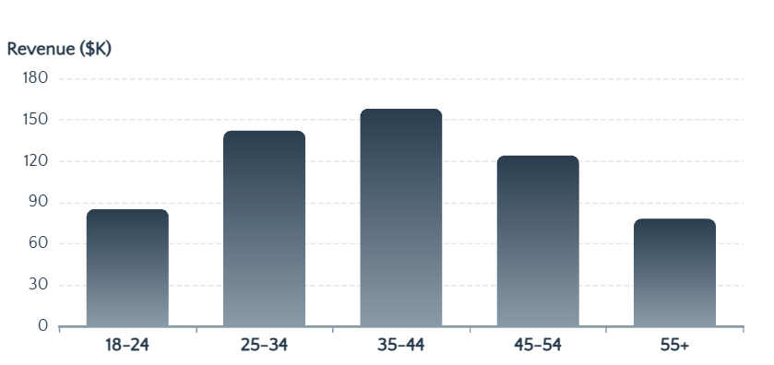
05
Revenue Analysis
Demographic analysis reveals high-value customer segments and revenue optimization opportunities.
Revenue by Gender
Revenue by Age Group
Female
58%
Male
42%
Subscription Impact
Subscribers Avg. Spend
$285
65% higher than non-subscribers
Non-Subscribers Avg. Spend
$173
Baseline spending pattern
High-Value Customers
Customers using discounts but spending above average represent 23% of revenue.
Key Insights
Female customers generate 58% of total revenue, representing primary target segment
Insight: Discount users aren't necessarily price-sensitive
Subscribers show 65% higher average spend, highlighting subscription value
Age 25-44 represents peak earning years and highest revenue contribution

Slide 8
06
Product Performance
Product analysis identifies top-rated items, category leaders, and discount positioning opportunities.
Top 5 Products by Rating
Top 3 Products per Category
Discount-Dependent Products
Premium Wool Sweater
Clothing
Summer Dress
78%
Exceptional quality and comfort drive satisfaction
1. Premium Wool Sweater
2. Organic Cotton Tee
Seasonal item requiring promotion
Organic Cotton Tee
3. Slim Fit Jeans
Sustainable materials resonate with customers
Casual Sneakers
65%
Slim Fit Jeans
Footwear
Competitive category
Perfect fit and durability earn loyalty
1. Leather Ankle Boots
2. Running Sneakers
Basic Hoodie
58%
Leather Ankle Boots
3. Casual Loafers
Premium craftsmanship justifies price
Price-sensitive segment
Accessories
Cashmere Scarf
Luxury accessory drives satisfaction
1. Cashmere Scarf
2. Leather Belt
3. Canvas Tote Bag
Strategic Implication: Top-rated products should be featured in marketing campaigns, while discount-dependent items need pricing strategy review to improve margin sustainability.

Slide 9
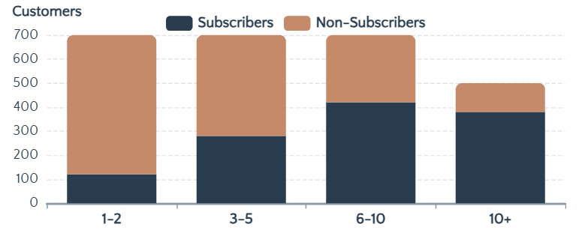
07
Behavior Patterns
Behavioral analysis uncovers discount usage patterns, shipping preferences, and subscription correlations.
High-Spending Discount Users
Purchase Frequency & Subscriptions
23%
Customers who used discounts but still spent above average represent significant value.
of Revenue
Insight: These customers leverage discounts strategically without compromising total purchase value.
Shipping Type Comparison
Behavioral Insights
Express
Standard
Repeat buyers (>5 purchases) show 72% subscription rate
$267
$198
Express shipping correlates with 35% higher purchase values
Avg. Purchase
Avg. Purchase
High-spending discount users demonstrate strategic shopping behavior
35% Higher Value: Express shipping users demonstrate premium spending behavior.

Slide 10
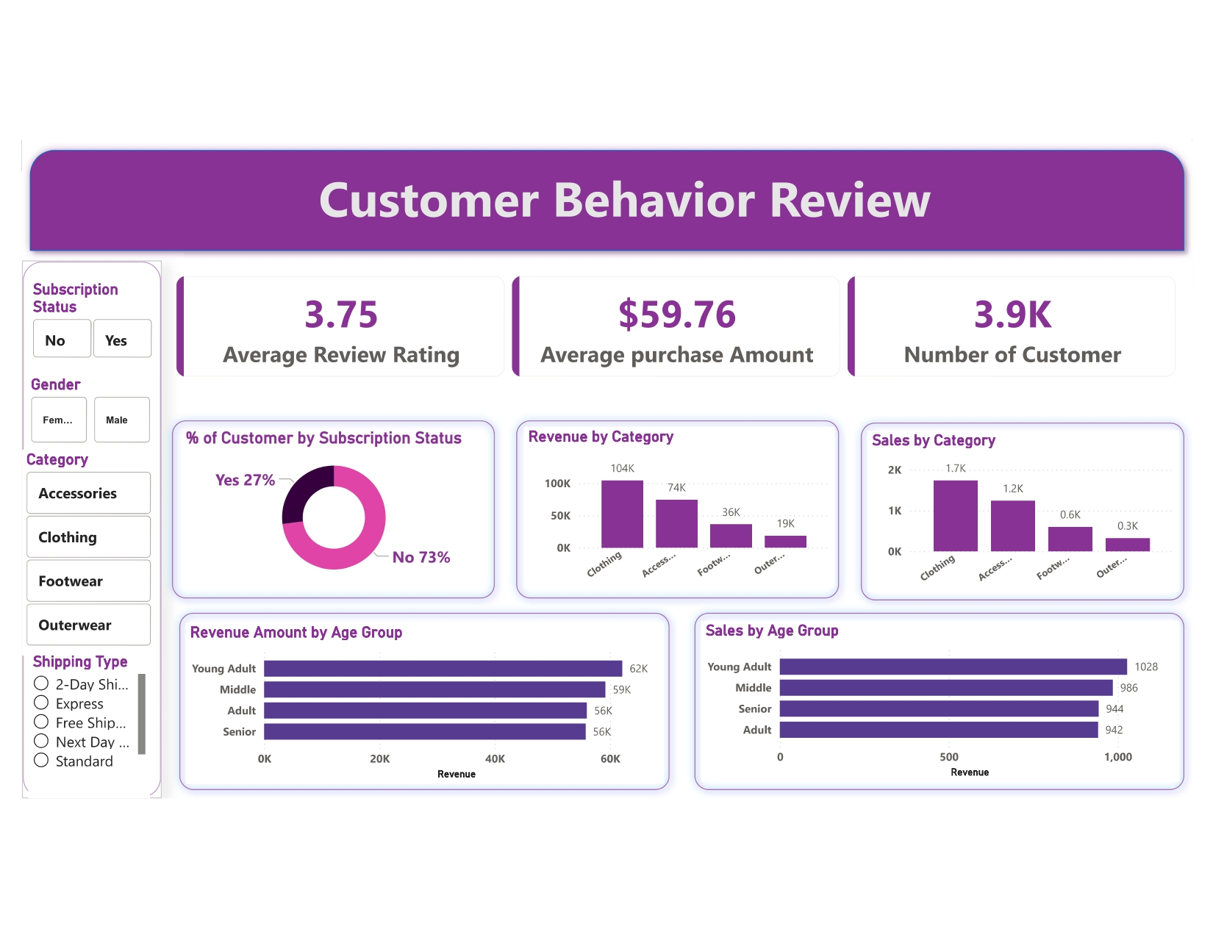
08
Interactive Dashboard
Power BI dashboard consolidates all analytical insights into an interactive visual experience, enabling real-time exploration of customer behavior patterns.
Dashboard Components
Executive Summary
High-level KPIs including total revenue, customer count, AOV, and subscription rate
Customer Segmentation
Interactive filters by segment, age, gender with drill-through to customer details
Revenue Analysis
Revenue trends by demographics, subscription status, and time periods
Product Performance
Top products by category, ratings, discount dependency with dynamic filtering
Behavior Analysis
Purchase frequency, shipping preferences, discount usage patterns
Dashboard Benefits
• Real-time data refresh
• Interactive filtering & cross-filtering
• Self-service analytics capability
Live Data Integration: Real-time customer behavior monitoring
• Mobile-responsive design

Slide 11
09
Strategic Recommendations
Data-driven initiatives to maximize customer value, optimize pricing strategy, and enhance competitive positioning.
01
Boost Subscriptions
04
Product Positioning
Insight: Subscribers spend 65% more than non-subscribers.
Insight: Top-rated products drive customer satisfaction.
Action:
Promote exclusive benefits & early access
Action:
Highlight best-sellers & leverage social proof
02
Customer Loyalty Programs
05
Targeted Marketing
Insight: 65% of customers are in New/Returning segments.
Insight: Female customers (58%) and Express users drive revenue.
Action:
Reward repeat buyers & implement tiered benefits
Action:
Focus on high-revenue demographics
03
Review Discount Policy
Implementation Priority
Insight: Some products have 78% discount dependency.
Phase 1: Subscription & loyalty initiatives (Q1)
Phase 2: Discount policy review (Q2)
Action:
Balance sales boosts with margin control
Phase 3: Marketing optimization (Ongoing)
Expected Impact: These initiatives can potentially increase customer LTV by 25-35% and improve profit margins by 8-12% .

Slide 12
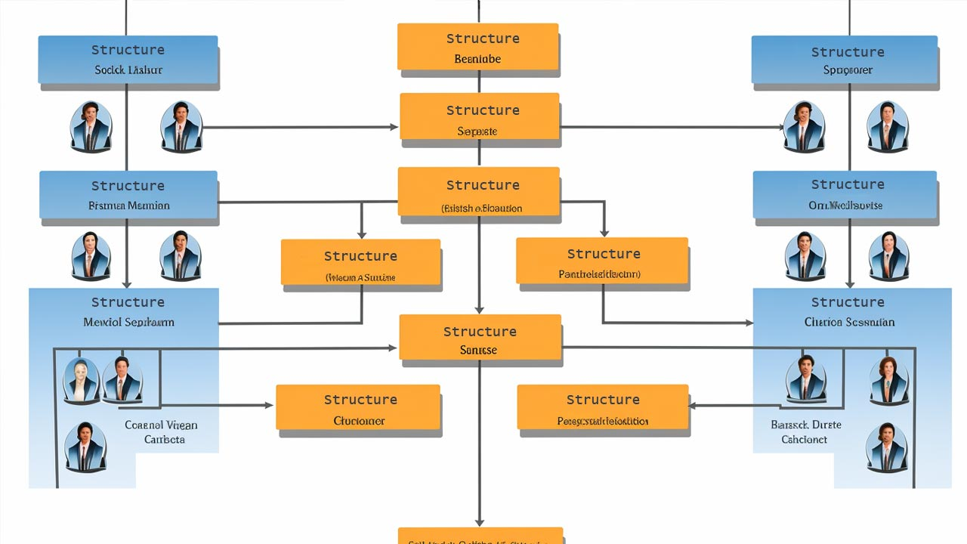
GitHub :- sujeetkumar22
Data-Driven
Success
Empowering business decisions through
analytical rigor and customer understanding
Transactions Analyzed
Key Insights
Strategic Initiatives
3,900
10+
5
"Transforming customer data into competitive advantage"

